Slide 1
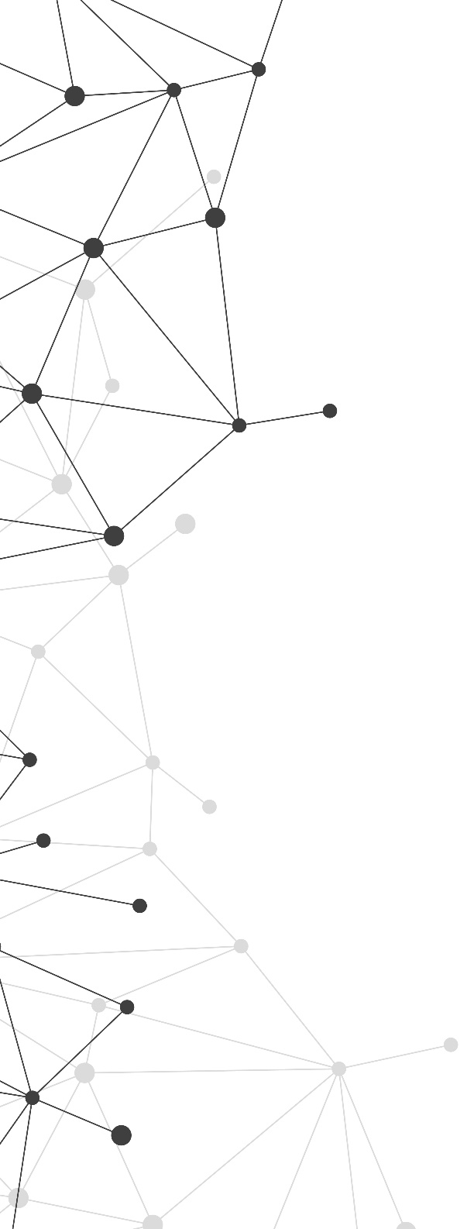

Microsoft Defense & Intelligence: Strategy Overview
Kate Maxwell
CTO Defense & Intelligence
Microsoft Worldwide Public Sector
Notes:
Welcome, and thank you for being here with us today!
Kate introductions – credentials & background, + why she came to Microsoft.
Software and Systems Engineer by trade, entire career spent serving allied defense organizations as a civilian technologist
18 years in the Defense Industrial Base before coming to Microsoft.
I am an alumni of Raytheon Technologies, where I began my career by writing software for the US intel community, and eventually expanding my work into the FVEY community and beyond, including lots of initiatives around modernizing the way we build, deploy, operate, and sustain mission capability.
I’m a huge fan of Digital Transformation and the adoption of modern development paradigms to improve and accelerate innovation cycles, and that is what brought me to Microsoft two years ago.
So, there is a special place in my heart for the manufacturing community and the defense industrial base at large.
We are thrilled to have you joining us here today, and we are
Agenda for this briefing:
Share a brief overview of our Defense & Intelligence Strategy at Microsoft
Dive a bit deeper into one of our industry priority scenarios, which relates to the mission capability lifecycle and Digital Engineering
Set the stage for the discussions and presentations across the rest of the day
We want this to be a conversation, not a series of one-way presentations. So please raise questions, share your thoughts and feedback, and we would love to learn more from you about your priorities, challenges, and goals and how we at Microsoft can help support those.

Slide 2

Defense & Intelligence:
Empowering the service personnel who protect and defend to achieve more.
Notes:
Our desire is to be a mission partner to allied defense organizations around the world, and to empower the service personnel who protect and defend to achieve more. That is our mission statement.
We work with Defense & Intelligence organizations around the globe to help them achieve their digital transformation goals – including cloud and commercial technology adoption, speeding up innovation cycles and adopting modern methods and practices like DevSecOps, Digital Engineering, and Software Factories for defense, and also supporting organizational transformation and skilling initiatives to ensure that real change happens and takes hold.
Historically, when most people think Microsoft, they don’t typically think about business with defense forces and militaries.
Microsoft as a company has more than 40 years of experience supporting democratically elected institutions and defense forces.
The missions that you support matter, and as a company, we have made a principled decision to use technology to support allied, democratically-elected governments in defending freedom around the globe.
Our team is comprised of many former military and defense industrial base personnel, and we resonate with these missions.
Given recent world events, we are also acutely aware of the changing role of tech companies in the global theater, with recent events in Ukraine and cyber operations by Russia being one such example.
We are thinking hard about this, and we are working to cement our place and partnership with defense organizations as a result.

Slide 3
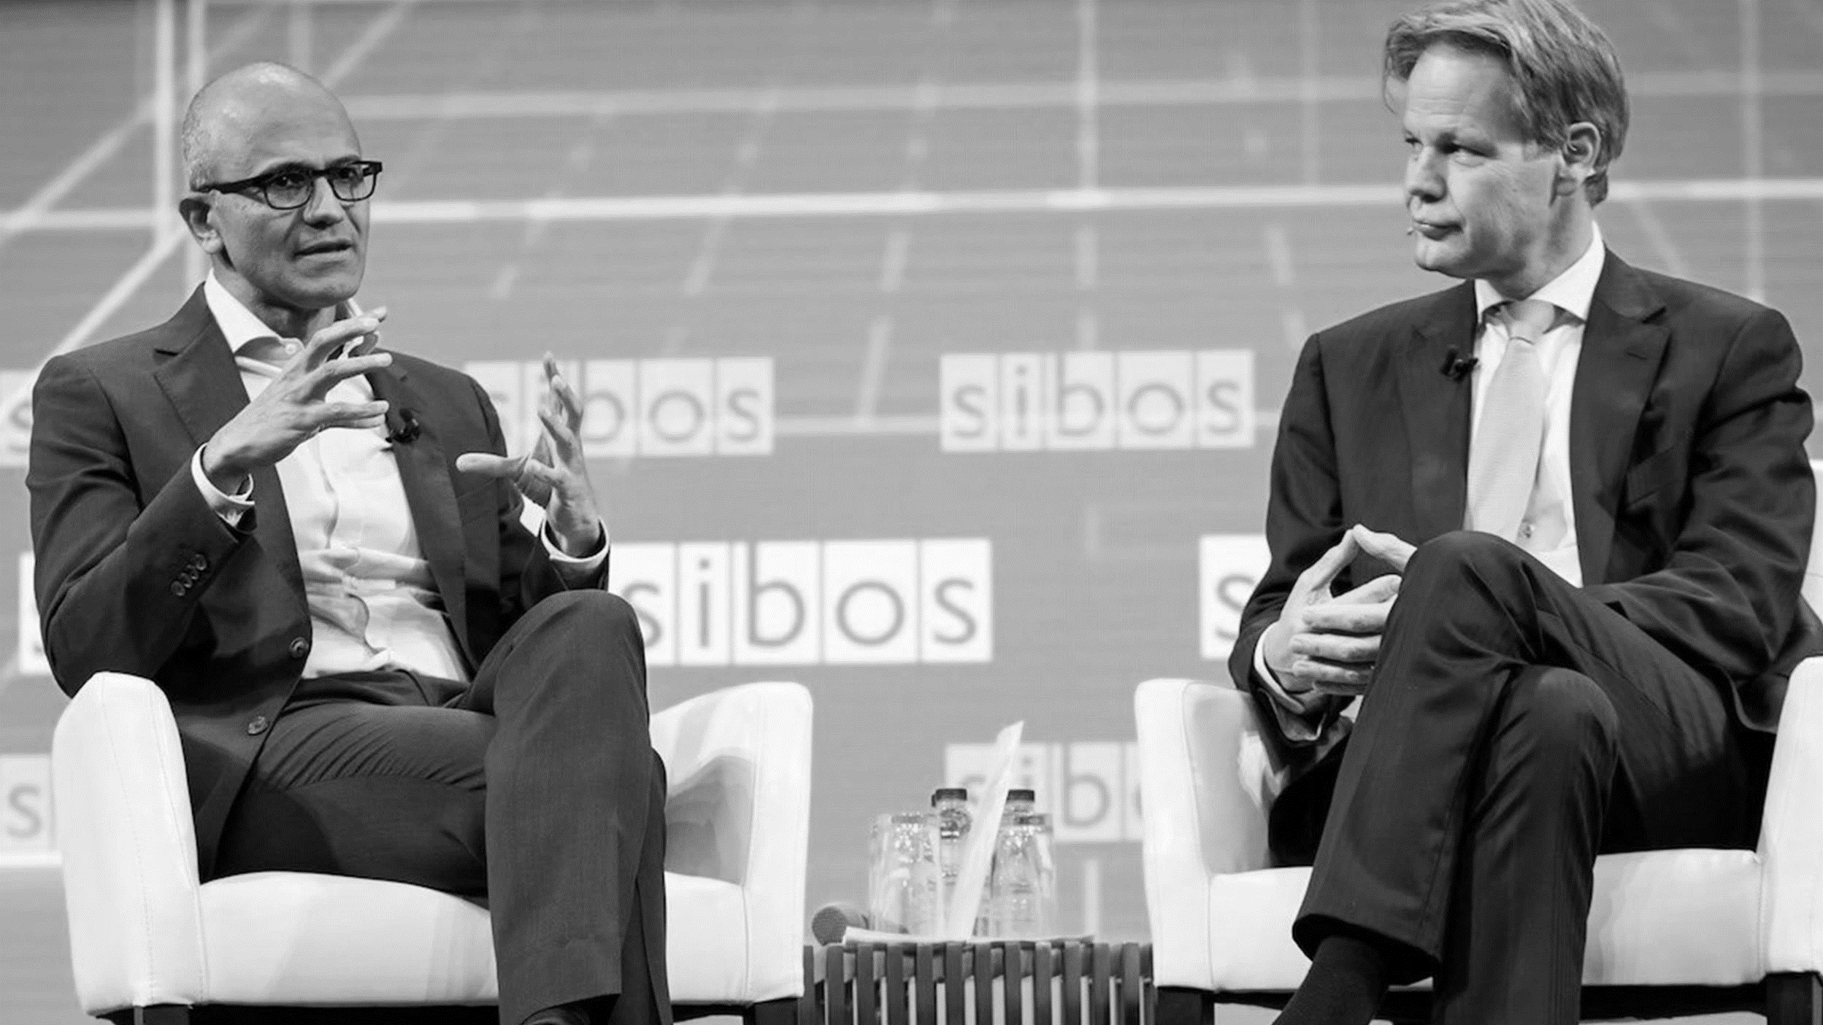
TECH INTENSITY
“We must adopt technology in ways that are much faster than anything that we have done in the past.“
- Satya Nadella
Notes:
So, related to that, our CEO Satya Nadella has reinforced our commitment to the Public Sector and to the allied defense ecosystem.
And we are pushing especially hard to help defence forces embrace what we call “Tech Intensity” – helping them adopt technology in ways that are much faster than what they have done in the past.
Tech intensity has three components:
Rapid adoption of hyper-scale cloud platforms.
A decision to invest in digital capabilities AND the supporting culture and skilling initiatives needed to help digital capabilities take hold.
Relentless focus on building technology that is secure and that users can trust.
The bottom line is this: the methods and tactics that adversaries are using is increasingly hybrid in nature, which means that a modern military posture needs to be increasingly software-defined, and it needs to include the ability to innovate at speed.
We believe digital transformation can enable that.

Slide 4

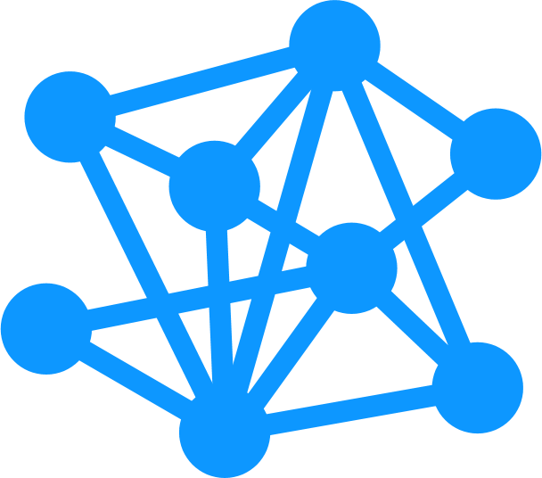

DIGITAL TRANSFORMATION OF THE DEFENCE ECOSYSTEM
Disruptive Defence & Intel
Digital
Defence & Intel
Advanced Defence & Intel
Analog Defence & Intel
People and culture
Policy, governance, and acquisitions
Technology and data
Notes:
We work with defense customers and partners all over the planet to help them define their own digital transformation goals and objectives, and then figure out how to get there.
There are essentially four stages of maturity for digital transformation for defense – Analog, Advanced, Digital, and Disruptive.
And this chart is one that we use to foster conversations to first understand where a customer or partner may be on their own digital transformation journey.
These stages look clearly delineated, but the journey is not necessarily a serial or linear one. Oftentimes, we find defense organizations working simultaneously in multiple phases. For example, we frequently see defense customers developing advanced capabilities that are digital or disruptive in nature – indicative of being in a latter stage - but they don’t have the foundational digital backbone, culture, or policies in place yet to truly take advantage of those capabilities.
Or perhaps they are building advanced, digital capabilities, but still running antiquated back-office processes and policies that are not digital, data-driven, or optimized.
This digital maturity model is a great tool to help us have candid discussions with customers & partners so they can honestly assess where they are in their transformation journey. And part of this activity includes talking through what goals and objectives defense customers want to realize through their transformation.
So we won’t go through this in depth today, but we would love to explore this with you and understand where you are in this maturity spectrum, and also, what is your “why” statement for transforming? What are your goals for digital transformation, what is working, what are your challenges, and what mission and people outcomes do you ultimately want to achieve?
--------------------------------------
Additional info, if you want to use it (and if time permits):
Now, let’s talk through the stages of digital transformation for defense.
Analog - The analog phase of the journey is common to many parts of defense & intelligence – this is where processes are still very waterfall in nature, not optimized around data, and rely heavily on paper and physical environments for delivery.
Example: Paper manuals, electro-mechanical training aids, and checklists as tall as I am. Mission Planning exercises being drawn in the dirt, in-theater.
Advanced - starting to digitize some services and processes, but not yet truly digital from end-to-end. A lot of your data might still live in stovepipes, and most of your systems are on-prem- and most likely constrained by proprietary IP. That limits your ability to truly harness data as an asset and elevate it to actionable insights that can be shared across services and domains.
Example: UK MoD has a dozen different digital timecard applications out there. Same is true of logistics (lots of app duplication). Good progress in making these digital, but ultimately need to consolidate down to a single app, available everywhere and with broad adoption.
Digital – this is where you truly begin delivering digital services that are agile and flexible, across the entire organization. Increased focus on user experience, and using Digital Engineering methods and DevSecOps to deliver and deploy at speed and scale. Starting to use more advanced capabilities like AI/ML for insight generation, sharing data across domains and from HQ to edge, modular and interoperable, AR/VR/MR/modeling & sim, and some digital engineering methods in place.
Example: Software Factory for Defense. USAF, DHS examples. Building and deploying new mission capability at speed and scale.
Relate this to the UK MoD Foundry work that is underway now.
Example: Leveraging Modeling & Simulation capabilities for wargaming; COA generation; mission training & planning. Very data-rich and personalized experiences.
Example: BAE Project Vulcan and Thales Nexium Defence Cloud are good examples of a step change in driving disruptive technology into a legacy-orientated, land-based environment to demonstrate and prove out the value of cloud-based services paired with modern comms architectures.
Disruptive – this is the holy grail of digital transformation for defense. The organization is digital, agile, and innovative. Data and insights are available across the entire mission thread, at the time and place of need – including at the tactical edge. Can disrupt not just adversaries, but also your own organization, and at speed. Digital Engineering firmly entrenched in all methods and processes. Data-driven and optimized. Highly capable, advanced tech, cloud-first strategy. Collaborative across entire mission threads, domains, agencies, coalition partnerships, and geographic bounds.
What does this look like? A secure, connected, interoperable end-to-end cloud solution, from HQ to tactical edge. Allows you to leverage existing and novel data, elevate that data to insights, make data-driven decisions, and access data anywhere, anytime. Also allows you to be agile, pivot, and disrupt at speed and scale while capitalizing on human-machine augmentation. The ability to leverage data and insights from multiple sources enables information advantage and agile multi-domain integration.
Angie’s example: UK data logistics & warehousing story. Employees wearing headlamps; no electricity on-site. Had to reskill the workforce and bring them along on the journey. Get them behind the “why” of digital transformation and the value proposition of it as it relates to their individual job function. Helped them step through the Digital Transformation journey.
JADC2 as an example:
Where do we see Joint All-Domain Command and Control (JADC2) on this chart?
If we follow the same network-centric warfare developments from the nineties, the defense ecosystem is at risk of failing to deliver true JADC2 – again!
How willing are we to be disruptive? How willing are we to challenge Government acquisition and procurement methods? How willing are we to challenge ourselves to truly enable a disruptive defense & intelligence ecosystem?
Bottom line: it takes more than technology change. Need to also change people, culture, policy, governance, and acquisitions (as we see on the bottom of this slide).
Question for customer (generate dialogue):
Where do you see MoD on this maturity model?
So let’s talk about those process, policy, and cultural enablers for transformation… (next slide)

Slide 5



















Cybersecurity & Zero Trust Architectures
Modeling
& Sim
AI/ML
Mixed Reality, Gaming,
& the Metaverse
Technology Enablers
Edge
Computing
Intelligent Cloud
5G & Space
ProductivityTools
Intelligent Edge
Trusted
Microelectronics
Digital Engineering & DevSecOps
Process, Policy, & Cultural Enablers
Business Process
Acquisitions
Risk & Reward
Hybrid Work Environment
Diversity
Culture
Notes:
There are many technology trends contributing to a transformed defense posture, and we are working with both defense forces and the DIB to leverage commoditized tech, emerging capabilities, and modern development methods in their defense tech stack.
You’re going to hear about a few of these today – Artificial Intelligence; 5G, Space, and Spectrum; Edge Compute and the full Cloud-To-Edge continuum; Modeling & Sim; Digital Engineering Methods.
In all of these, Cloud Computing playing a central role and serves as the foundation for a modern, secure, data-driven, defense posture.
I’ll also note one additional thing on this slide:
Digital transformation is not just a technology story.
Real transformation happens at the intersection of people, technology, and culture – and there are a lot of non-tech enablers that are needed for the defense ecosystem to truly transform.
You’ll see a selection of those highlighted at the bottom of this slide.
Business Process
Defense Acquisitions Methods
Risk & Reward Postures
Hybrid work environments
Diversity – both in the workforce, and in your supply base
And finally, Culture.
Culture underpins every single transformation effort on the planet, and it will make or break your transformation efforts.
Make sure you have the right organizational change management practices in place to help drive your organization, and the culture itself, to where it needs to be to ensure digital transformation success.
We do a lot of code-with and co-engineering partnerships with the Defense Industrial Base – we have some great examples we can share with you from BAE Systems and Rolls Royce in particular – and those include not only side-by-side development engagements, but also opportunities to assess and rework business processes, workflows, and even culture and team dynamics. I cannot oversell how important culture is to a transformation effort, and having gone through our own transformation and cultural overhaul here at Microsoft, that’s an area that we are happy to support based on our own experiences and lessons learned.

Slide 6
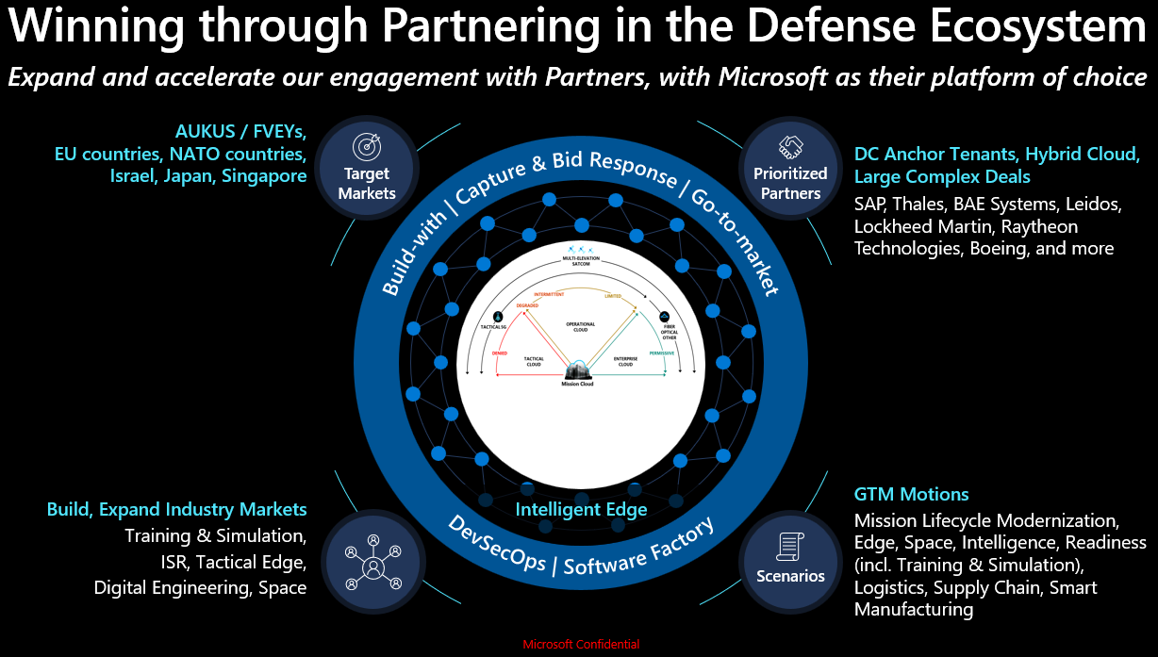
Microsoft Global Defense Strategy
Mission: Support digital transformation initiatives for global Defense & Intelligence customers and partners.
Enable Digital Transformation through:
Skilling, adoption, and utilization of the public cloud to develop cloud competencies and cultural enablers that yield mission outcomes for customers.
Targeted investments in mission-centric capabilities so our customers can leverage best of breed technologies and methods to increase the speed of innovation.
Partner with the Defense Industrial Base to weave commercial solutions and dev methods into mission capability lifecycle to ensure interoperability, security, velocity, and the best value and performance for customers.
Notes:
<Describe 3 ways we enable Digital Transformation>
And I want to put a finer point on that third bullet – the Partner piece.
70% of defense spending is done through government-contracted work with the DIB as prime contractors. DIB companies have strong, longstanding relationships with Defense forces, they already have multi-year, multi-million & billion-dollar framework contracts in place, and they know how to bid, win, and execute in the complicated world of government contracting.
We take two primary approaches with the DIB:
1) Traditional approach – sell TO the DIB. Think products & cloud services for productivity, collaboration, security, etc.
2) New focus: sell WITH the DIB. Partner on joint capture & pursuit efforts. Engage in co-development and co-engineering efforts.
We want to partner with you to help increase your Pwin on new business opportunities, and to help keep your franchise programs sold.
In these sell-with scenarios, the DIB typically primes, and we act as a sub bringing the digital backbone and cloud-enabled capabilities to the opportunity.
What’s in it for you is higher Pwin, increased innovation, and easier access to technology by weaving commercial solutions into your offerings.
What’s in it for us is adoption and growth of our platforms and solution offerings.

Slide 7
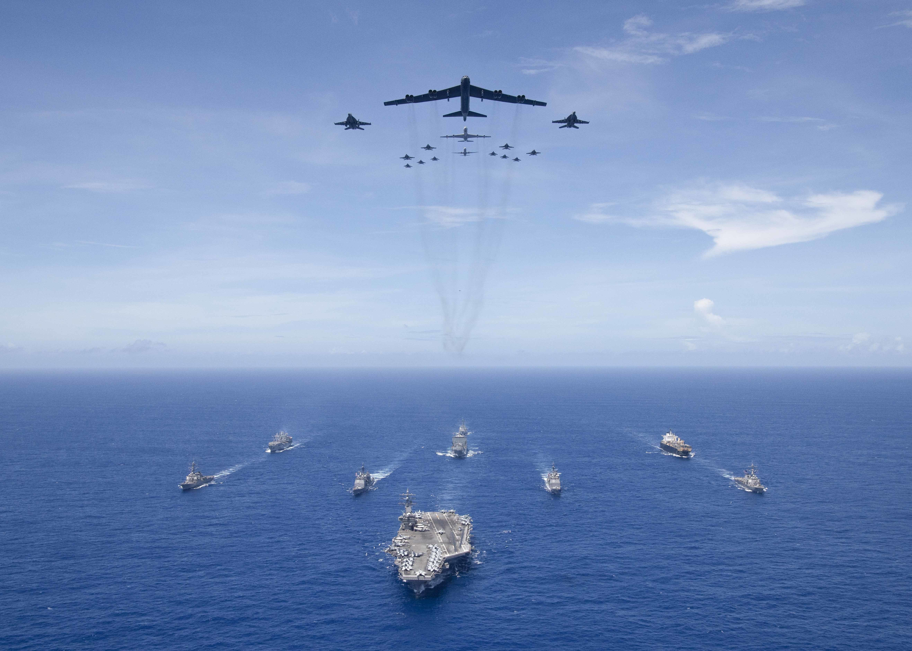


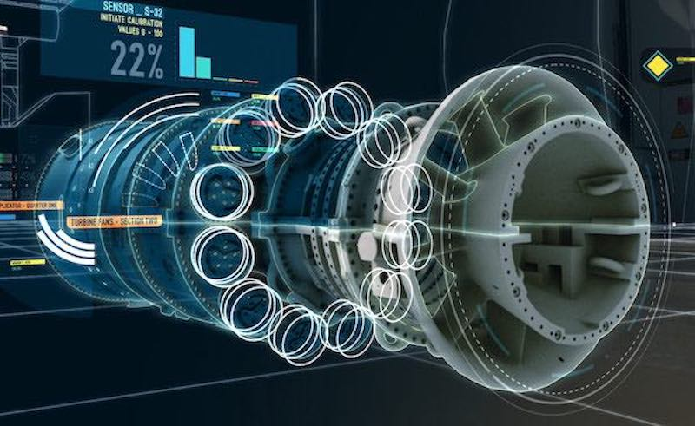

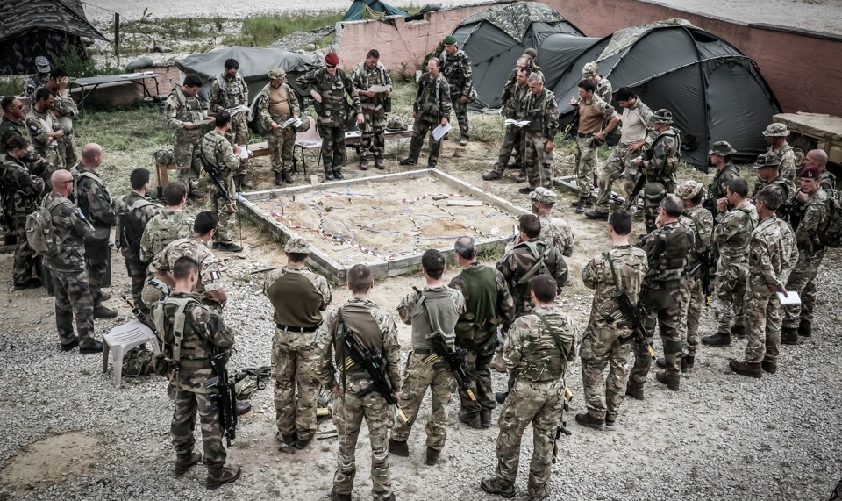
Microsoft Defense & Intelligence Priority Scenarios
Empowering militaries. Improving operations. Protecting national security.
Deliver a Trusted and Secure Digital Backbone
Empower Personnel and Modernize Facilities​
Transform the Capability Lifecycle
Optimize Decision Advantage
Enhance Interoperability​
Distribute secure cloud enabled capabilities across platforms, infrastructures, and services.
Securely meet the needs of military personnel and their families and digitally improve facilities and services.
Transform military capabilities through concept, design, procure, build, maintain, and dispose in partnership with the defense industrial base.
Leverage AI/ML and automation to modernize intelligence, underpin readiness and optimize mission planning and execution.
Enable secure data and information sharing with partners, allies and agencies.
7
Notes:
Here are the five primary Industry Priority Scenarios for Defense & Intelligence in which we focus our time and energies, based on guidance and feedback received from our customers.
Deliver a Trusted and Secure Digital Backbone – this is all about cloud adoption, as well as modernization of IT and technology stacks
Empower Personnel to deliver Mission, and Modernize Facilities – this is where we are focused on leveraging digital transformation to modernize the individual defense worker experience; everyone from the soldier serving at the front lines, to the defense office worker at headquarters, to the engineer working in the defense industrial base.
Transform the Capability Lifecycle – this is probably my favorite IPS, having come from the Defense Industrial Base, and it’s one we are going to dive in further on in a moment. This is all about transforming the way forces and DIB conceptualize, design, collaborate, deploy, and sustain mission capability, with focus on leveraging modern methodologies and digital capabilities such as Digital Engineering, Agile, DevSecOps, Digital Twin, and so on. The intent here is to modernize the lifecycle and enable innovation at the speed of relevance.
Optimize Decision Advantage – this is about helping forces to harness their data as an asset and accelerate the OODA loop – Observe, Orient, Decide, Act.
And finally, Enhance Interoperability. This is focused on enabling secure information exchange across partners, coalitions, and with industry. So think about the major coalitions and alliances we support – AUKUS, FVEYs, NATO, etc. This directly focuses on those alliances and how we help those forces work together across nations, across networks, across missions, across environments.
<Pause for questions on strategy before diving further into one of these IPSs>

Slide 8
Transforming the Mission Capability Lifecycle
Notes:
Let’s dive a bit deeper now into our third industry priority scenario, which you saw on the previous slide: Transforming the Mission Capability Lifecycle.
We believe that Digital Engineering is the next big paradigm shift and enabler for military technology dominance. It’s how we build systems better and help defense forces innovate at speed and scale. This is an area I became passionate about while working in the Defense Industrial Base, and it’s what eventually brought me to Microsoft. This is how the allied defense ecosystem stays ahead of a rapidly evolving threat environment – by enabling innovation at the speed of relevance through a modernized mission capability lifecycle.
And what this means for you, and for the Defense Industrial Base at large, is:
Improved efficiencies across the product lifecycle
Improved user feedback
More rapid time to delivery
Increased innovation

Slide 9


Modernizing Defense Capability Lifecycle
Current State
Desired State
Highly stove-piped;
information & capability silos
Common dev environment,
collaboration platform, code library
Legacy waterfall methods –
slow, rigid, manual, disconnected
Digital Engineering, DevSecOps –
fast, agile, automated, connected
Limited collaboration
Open & modular architectures
Risk-averse
Healthy risk postures and
fail-forward cultures
Security bolted on at end
Security baked in from start
Evolutionary innovation
Balanced innovation – evolutionary & revolutionary
Proprietary systems & capabilities
Leverage open source &
commoditized tech
Notes:
Here is a view of the Defense capability lifecycle today, vs. where we want to be in order to develop and deploy new mission capability at the speed of relevance.
<talk through current state vs. desired state>
And one thing I want to point to here is that while we are talking about the mission capability lifecycle, which is a very tech-intensive topic, many of the elements on this slide are driven more so by culture and policy than by technology itself.
For instance, most defense acquisition processes have been around for decades. They are well-suited for buying large, complex, platforms and systems with well-defined requirements and waterfall development and deployment methods.
But when we are talking about buying mission capabilities that are increasingly software centric, and buying those under rapid timescales, then our legacy defense procurement methods no longer work well.
I’ve heard some US Air Force leaders say they want to move this ecosystem from spending a decade buying and fielding a new system, to buying modular, software-centric capability with a credit card and getting it fielded in hours, days, and weeks, rather than a decade.
That’s a paradigm shift, and it requires not just technology, but also policy and culture change.
We spend time on The Hill, and with organizations like the Aerospace Industries Association, and with government acquisitions organizations around the world to attempt to influence policies to make them more modern and tech-friendly. And we do that side by side with the Defense Industrial Base.

Slide 10
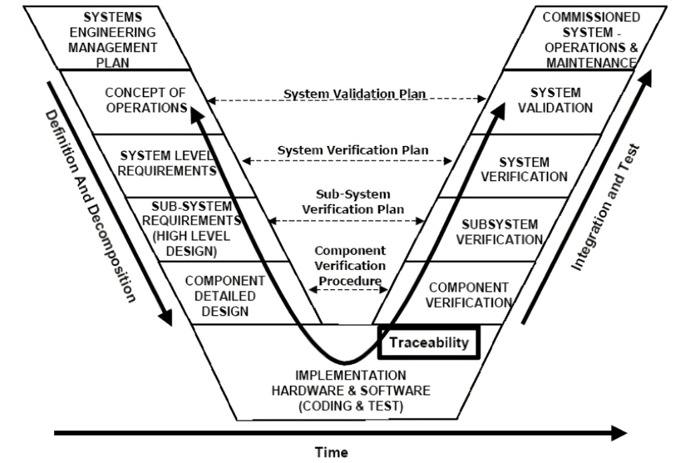
Legacy mission capability lifecycle
Systems Engineering “Vee”
Notes:
Let’s dive now into some engineering perspectives, and what this means for defense.
Here is a look at what has been in place for the past three decades or more with respect to mission capability development and lifecycle.
Anyone who has worked in SW, HW, and Systems Engineering in the DIB lives by this Systems Engineering Vee. We see it in our sleep.
But unfortunately, this is an antiquated approach, and it frequently goes hand in hand with waterfall development cycles.
Some of the challenges associated with this approach:
That lifecycle is traditionally executed very sequentially in nature.
All requirements are defined up front…which is darn near impossible to do in a rapidly changing threat and technology environment.
Very difficult to introduce new scope or unexpected changes mid-stream.
Limited opportunity for feedback; mostly excludes the voice of the customer and end-user after initial requirements analysis.
No prioritization of high-value capabilities. You have to wait for the entire system to be developed before it can be delivered.
Testing is reserved for the end, which increases risk of integration issues and usually results in higher cost and time to fix and change things.
So much of this is manual – and manual processes do not scale, nor move at speed.
Not to mention – critical elements like safety, security, and sustainability are afterthoughts. They are not baked into the system lifecycle, nor integral to any processes therein.
It’s time to overhaul this mission capability lifecycle. It made sense for legacy platform and hardware procurement, but it doesn’t work so well for modern, rapid, agile software procurement.

Slide 11
Modern mission capability lifecycle
DIGITAL TWINS
Sec
Model
Model based Production planning
Virtual Production System
Virtual
Model based definition
Virtual Qualification
+
CODE
DEPLOY
MODELING
SIMULATION
Model based systems Engineering
Virtual Certification
PLAN
Business Model
Virtual Operations
Dev
Ops
Market (Mission Model)
Digital Thread
Virtual Ecosystem
RELEASE
NEEDS
SOLUTIONS
BUILD
OPERATE
As-needed
As-offered
As-delivered
As-supported
DESIGN
DELIVERY
As-specified
As-certified
TEST
MONITOR
Design
As-designed
As-tested
Physical
As-planned
As-built
PHYSICAL SYSTEMS
The Boeing Model-Based Engineering (MBE) Diamond
DevSecOps
Notes:
So here is what the future looks like from an engineering perspective: it’s a combination of Model-Based Engineering + DevSecOps methodologies.
We believe this is a powerful combination that will unlock innovation at speed for defense forces.
Benefits:
This provides significantly greater agility in requirements, development, and deployment of new mission capability, because it’s iterative.
We don’t need to define 100% of the requirements up front, nor should we.
In a threat landscape like this, it’s near impossible to define all requirements up front anyway. The world is changing around us, so we need agility in our development methods.
This approach also prioritizes feedback loops - voice of customer is baked in throughout– so you have a constant feedback loop to drive the iterations and refine requirements as we go.
That allows you to prioritize high-value capability – don’t have to wait a decade to build against all requirements and then deploy one giant, monolithic system at the end (that likely has since become obsolete and no longer meets requirements).
Instead, we can deploy incremental capability, prioritized by customer.
This mirrors best practices from the commercial tech world, and it’s another great way to get frequent customer feedback…because you are putting new capability in their hands more regularly.
Everything in this approach is rooted in the digital thread and a data-driven posture.
The use of digital twin allows modeling of real-world AND simulated inputs – which allows integration of people, process, tools, and data, and enables testing of a near-infinite number of scenarios before ever going to production or even a physical prototype.
Bottom-line: this approach is data driven in every way, it is connected to the customer for constant feedback cycles, it is digital, and it is fast.
With this approach we are building systems, BETTER with faster design, integrated feedback loops, automated testing, frequent deliveries, and ongoing iterations.
This is what the future defense mission capability lifecycle looks like. And customers are already starting to adopt it.

Slide 12
Digital Engineering Core Tenets
Model-based engineering
Digital Culture & Workplace
Authoritative source of truth
Leverage a common, model-based engineering foundation, rather than legacy, document-centric methods.
Drive towards single, authoritative data sets with consistent system data and models across all engineering disciplines.
Model-based engineering
Authoritative source of truth
Technology innovation & platform
Digital Engineering
Technology innovation to improve engineering practices
Agile software methods
& automation at scale
Agile software
& automation
Leverage technology innovations across the stack – cloud & edge continuum, DevSecOps, CI/CD, Digital Twin, containerization, AI/ML, mixed reality.
Drive collaboration across the ecosystem using open architectures and common dev & data platforms.
Leverage agile methods to take an iterative, customer and mission-focused approach to development. Feedback loops are critical.
Prioritize capabilities that bring the highest value to users and mission. Automate processes wherever possible (e.g., metrics collection, test & validation, etc.).
Transformed, digital culture and workplace
Notes:
In summary, what we just described on the previous slide is DIGITAL ENGINEERING.
The formal definition of Digital Engineering is this:
Digital Engineering is an integrated digital approach using authoritative data and models throughout the entire development and life of a system – from concept through disposal.
This is increasingly popular in the Aerospace & Defense industry, because it essentially does two things:
It modernizes traditional systems engineering practices to build systems, better.
It takes advantage of commoditized tech, modeling & simulation, modern dev approaches, and AI to enable INNOVATION AT SPEED.
Digital Engineering is built around five key tenets:
Model-Based Engineering, as we discussed on the previous slide with the diamond model.
Authoritative sources of truth, which are the models and data sets used by all engineering disciplines across the entire capability or system being developed
Agile software methods and automation at scale, which brings iteration and user feedback into the capability lifecycle, and also helps automate important but sometimes painful tasks, like testing and metrics collection.
Technology innovations to improve engineering practices, such as DevSecOps, CI/CD pipelines and tools, Digital Twin, container orchestration, etc.
And finally, culture. This is critical, and it is foundational to the entire Digital Engineering movement. We have to get the culture right for any of this to work.
--------------------------------

Slide 13


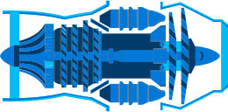
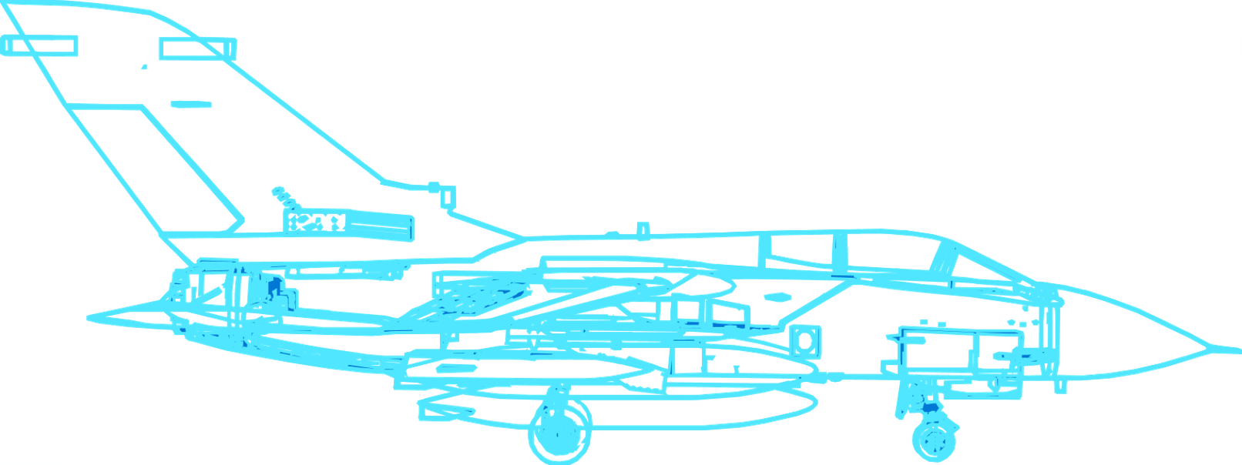
Digital Engineering Realized
1
2
3
4
5
Model-based engineering
Authoritative source of truth
Technology innovation
Agile Development & Automation
Digital Culture & Workplace
Feedback Loop
80%
90%
0.0
Fan
Digital Thread
Azure Cloud & Edge
Azure Digital Twins
M365, Teams
Azure DevOps
Azure IoT
Azure Defender, Sphere
Hololens
ISV Solutions
Azure Cloud & Edge
Azure Digital Twins
Azure HPC
Azure Virtual Desktop
ISV Solutions
Azure Cloud & Edge
Azure Digital Twins
Synapse
Zero Trust Security
Digital Thread
ISV Solutions
Azure Cloud & Edge
Azure Digital Twins
Azure DevOps
Azure AI/ML
Azure HPC
ISV Solutions
Azure Cloud & Edge
Azure Digital Twins
M365, Teams
Power Platform
Azure Data Share
ISV Solutions
Notes:
So, that all sounds great, but how do we bring Digital Engineering to life for our customers?
Well first, we start with engagements. We work side-by-side with our customers and partners on co-engineering efforts, where we help the customer develop IP, and we frequently teach Digital Engineering Fundamentals in the process. I’ll share some examples of this near the end of this deck.
We also offer a host of capabilities that support Digital Engineering, some of which we highlight on this slide.
I won’t go through all of these in detail, but let me call your attention to “ISV Solutions” listed at the bottom of each capability list.
This is where the real magic happens. When we bring non-traditional partners, including startups, into the defense tech stack, this helps bring innovation to the front lines.
One of our focus areas at Microsoft is to recruit an onboard ISV partners – also called Independent Software Vendors – onto our platform, so our customers can leverage their unique capabilities in their missions.
I/ITSEC example – a dozen M&S ISVs there at our booth, with us – demonstrating their wares on the Azure platform. You can take advantage of all of their capabilities and innovations from Day 1.

Slide 14
Customer Examples
Notes:
I’d like to close now by offering up a few customer examples related to Digital Engineering, and then I’d love to open the floor for any questions or discussion.

Slide 15
Common Digital Engineering Challenges & Blockers
Challenge | Strategy to Address
Shoe-horning Digital Engineering in with existing legacy business processes | Modernize business processes and culture to support the transformation
“Boiling the ocean” – trying to transition to Digital Engineering all at once | Select pilot projects at appropriate scale – then learn, refine, and grow.
Measuring progress and performance via legacy methods (e.g. EVMS) | Modern measures (e.g., OKRs, KPIs), agile metrics, and automatic metrics capture
Focusing on process and tools | Focus on people and mission outcomes
No common dev platform or ecosystem | Leverage an accredited, cloud-enabled platform to provide secure, interconnected infrastructure, collaborative dev environment, deployment sandbox, and dev tools (Agile, DevSecOps, CI/CD pipeline). Leverage dev low / deploy high wherever appropriate and possible. [Great opportunity to instantiate Software Factories!]
Legacy acquisitions approaches and contracting vehicles | Non-traditional vehicles (OTAs) & agile contracting methods
Risk-averse culture | Transformational leadership, learning-oriented, fail-forward culture, partnership with Big Tech and non-traditional vendors.
Notes:
Here is a small sample of real-world challenges that we frequently hear from our defense customers. I’d be curious to know if any of these resonate with you.
< walk through them >
In terms of addressing these challenges, we frequently partner with defense forces and the defense industrial base to address these. As an example, we recently engaged in co-engineering initiatives with a US Army customer, as well as BAE Systems, where our Commercial Software Engineering team spent a few months working side by side as members of the customer team while building new mission capability using modern development paradigms and methods. Those co-engineering engagements are very popular with our customers, because not only do those customers walk away with new capability and IP, but their engineers and product teams learn new skills and methods in the process.
This is a great way to help modernize your development methods – by doing it side-by-side with commercial experts who have done this many times over and can help navigate the common challenges and pitfalls associated with digital transformation and digital engineering adoption.
Moving to the next slide, I’ll share an example of one of those co-engineering initiatives that we conducted with the US Army Test & Evaluation Command, or ATEC.

Slide 16
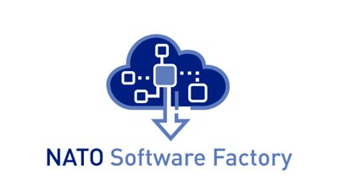
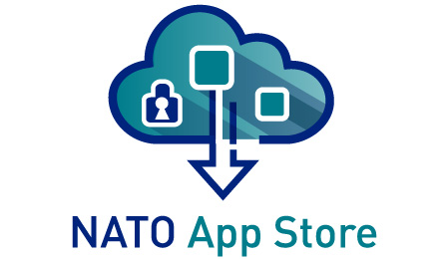
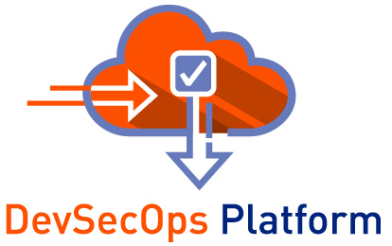
NATO Software Factory (NSF)
Vision: One Collaborative Engineering Environment
Alliance Federation
Industry
Academia
NATO App Store
Electronic distribution of NATO FAS apps to Nations via EDML
DevSecOps Platform Hybrid Cloud Requirements | Architecture | Design | Code | Work | Build | Test | Deploy | Release
Notes:
Here is another great example that I believe you may already be familiar with – the NATO Software Factory.
This is a leading example of a modern, collaborative environment for software innovation built on a shared cloud infrastructure. The magic here is centered around the fact that NATO members, industry, non-traditional vendors, and academia can all work together in that common environment, with easy transition between dev, test, and production environments.
AND we are leveraging hybrid cloud methods to support low side development and high side deployment.
There is still a lot of opportunity for maturation and growth here, particularly in terms of consolidating the many different innovation hubs and testbeds across NATO environments and nations and bringing them all into the core apps and dev environment in NSF.
There is also opportunity to do some app modernization and technology upgrades to resolve some legacy technical debt.
But on the whole, great things happening here, and it’s an excellent model and opportunity for the allied community at large.

Slide 17

Speed up time-to-value Vision for Continuous DevSecOps from NSF to Nations
Always production deployable
Automatically build and test code on every commit
Cloud-hosted pipelines for Linux, macOS and Windows
Any language, any platform, any cloud
Nation X
App Store
EDML (Alliance)
Nation Y
Public Cloud
Nations
Academia
NATO Enterprise
NATO on-prem
Industry
NATO
Notes:
Here is the real value proposition of the NATO Software Factory, and honestly, any Software Factory across the defense ecosystem: SPEEDING UP TIME-TO-VALUE.
With a Software Factory approach, you are standing up CI/CD pipelines that get your dev team up and running on day one. No more spending boatloads of time standing up environments. You use your pipelines, automate deployment of environments to the greatest degree possible, and focus on creating value for customers.
In the case of the NATO Software Factory, we have a DevSecOps platform that is being leveraged across nations AND industry partners, with an app store open to the alliance. This is a great example for the Public Sector, and it continues to mature and evolve.

Slide 18




The digital model approach is exciting in that it becomes the collaboration tool that unlocks the clock and unlocks the speed with which we can bring these products to market.”
Winning through Digital Engineering Transformation and Continuous Innovation
All digital presentation of B-52 CERP proposals
Digitally engineered the wing, pylon, nacelle, engine integration, gearboxes, fuel flow, electrical systems, thrust, weight, circumference of the engine and nacelle diameter
$2.6B contract win based on digital engineering verification and validation driving down maintenance, sustainment costs and improving efficiency
– John Bell
Rolls-Royce North America President and CEO
Notes:
Another example, this one from the Defense Industrial Base.
We have been working with Rolls-Royce to leverage digital engineering techniques, as well as modeling and simulation. They are now using an Advanced Visualization Lab that allows them to interact with digital models of products that have not even gone to production yet. They refer to that as “zero cost prototyping,” and it allows you to accelerate what would typically be post-production testing into earlier phases of the design lifecycle.
That is a gamechanger, and it is helping Rolls to drive down their development, maintenance, and sustainment costs through digital engineering methods and modeling & simulation techniques.
https://www.airforcemag.com/rolls-royce-digitally-modeled-entire-wing-pylon-to-win-b-52-engine-contract/
https://techpoint.org/2021/12/rolls-royce-is-winning-big-through-digital-transformation-continuous-innovation/

Slide 19
U.S. Army Test & Evaluation Command engagements
Challenges & customer needs:
Modernize legacy engineering capabilities
Transition from Waterfall -> Agile approaches
Reduce delays in end-to-end testing
Increase process automation
Develop across multiple networks and classifications
Example Architecture:
Microsoft Engagements:
Co-engineering to teach Digital Eng. Fundamentals
Established CI/CD pipelines
Dev Low / Deploy High environments and workflows
Engineering for Reuse (Code Libs, Terraform patterns, etc.)
Technical Engagements in:
Azure DevOps
Cloud migration, infrastructure, edge, landing zones
Configuration Management / Version Control (Git)
Containerization and orchestration (Kubernetes)
Identity
Security
Notes:
And finally, here is an example of a code-with engagement we have been conducting with the US Army Test & Evaluation Command.
<share details>
So, in summary, we believe Digital Engineering and the modernization of capability lifecycles is a huge opportunity for the Defense Industrial Base, and we are here to help you in that journey.
Happy to engage with you in workshops to identify goals and assess what your engineering and value steams look like today, and then figure out best path forward.
The code-with opportunities I mentioned are a great way to start – you get a Microsoft dev crew working alongside your engineers for some period of time (6-8 week engagements), you get to keep all of the IP as a result of that engagement, and your engineers learn agile, modern dev methods along the way. We have Defense-specific crews who work exclusively in this domain, they come with security clearances, and they have proven super popular with other DIB partners.

Slide 20
68
Thank you
Notes:
With that, thanks again for joining us today, and would love to hear from you before we move on to our next topics.
Questions on strategy or Digital Engineering? Where is Saab in the Digital Transformation and lifecycle modernization journey? What is working? Where do you need help?

